Slide 1

Fundamental of Testing

Slide 2
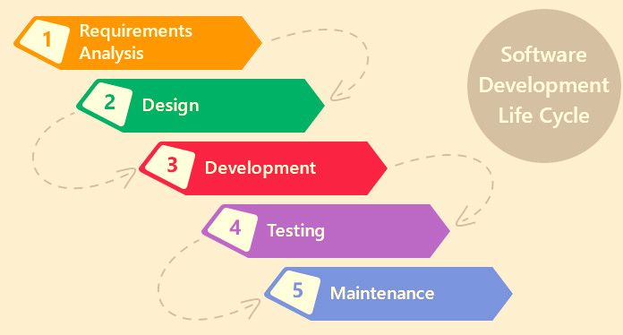
SOFTWARE DEVELOPMENT LIFE CYCLE
Testing
Types
STLC
Planning
Environment
Closure
Terminology
SDLC
Benefits
Levels
Requirement
Development
Execution
Bug-LC

Slide 3
TESTING
WHAT IS SOFTWARE TESTING?
SOFTWARE TESTING is defined as an activity to check whether the actual results match the expected results and to ensure that the software system is Defect free.
Software testing also helps to identify errors, gaps, or missing requirements in contrary to the actual requirements.
In simple terms, Software Testing means the Verification of Application Under Test (AUT).
WHY IS IT IMPORTANT?
Testing is important because software bugs could be expensive or even dangerous. Software bugs can potentially cause monetary and human loss, and history is full of such examples.
In April 2015, Bloomberg terminal in London crashed due to software glitch affected more than 300,000 traders on financial markets. It forced the government to postpone a 3bn pound debt sale.
Nissan cars recalled over 1 million cars from the market due to software failure in the airbag sensory detectors. There has been reported two accident due to this software failure.
Starbucks was forced to close about 60 percent of stores in the U.S and Canada due to software failure in its POS system. At one point, the store served coffee for free as they were unable to process the transaction.
Some of Amazon's third-party retailers saw their product price is reduced to 1p due to a software glitch. They were left with heavy losses.
Testing
Types
STLC
Planning
Environment
Closure
Terminology
SDLC
Benefits
Levels
Requirement
Development
Execution
Bug-LC

Slide 5
TESTING
Psychology of Testing
Testing
Types
STLC
Planning
Environment
Closure
Terminology
SDLC
Benefits
Levels
Requirement
Development
Execution
Bug-LC

Slide 6
TESTING
Tester’s and Developer’s Mindsets
Testing is in a way a destructive process and a successful test case is one that brings out an error in the program. Detection of an error/failure is a success as far as a test engineer is concerned.
The mindset to be used while testing and reviewing is different from that used while developing software. Separation of responsibilities of development and testing are done to
help focus efforts and provide an independent / unbiased view. While a certain level of independence often makes the tester more effective at finding defects and failures, this independence can however not replace familiarity which developers possess. People and projects are driven by objectives.
For example,
to find defects and confirm that the software meets it objectives. It is therefore important to clearly state the objectives of testing. Identifying failures during testing may be perceived as criticism against the product and its author. Testing is therefore often viewed as a destructive activity.
Communication of errors in the product in a constructive way therefore assumes particular importance in order to make testing appear constructive and supportive.
The Test Leaders and Testers therefore need to have good interpersonal and communication skills to overcome this difference of perception.
Testing
Types
STLC
Planning
Environment
Closure
Terminology
SDLC
Benefits
Levels
Requirement
Development
Execution
Bug-LC

Slide 7
TESTING
Testing
Types
STLC
Planning
Environment
Closure
Terminology
SDLC
Benefits
Levels
Requirement
Development
Execution
Bug-LC

Slide 8
BENEFITS OF SOFTWARE TESTING
Cost-Effective: It is one of the important advantages of software testing. Testing any IT project on time helps you to save your money for the long term. In case if the bugs caught in the earlier stage of software testing, it costs less to fix.
Security: It is the most vulnerable and sensitive benefit of software testing. People are looking for trusted products. It helps in removing risks and problems earlier.
Product quality: It is an essential requirement of any software product. Testing ensures a quality product is delivered to customers.
Customer Satisfaction: The main aim of any product is to give satisfaction to their customers. UI/UX Testing ensures the best user experience.
Testing
Types
STLC
Planning
Environment
Closure
Terminology
SDLC
Benefits
Levels
Requirement
Development
Execution
Bug-LC

Slide 9
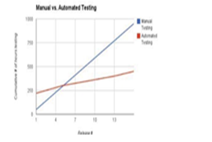
Introduction to Automation
Automation Vs. Manual
Manual Testing
Testing is time consuming and tedious
Delay the ability in thoroughly testing an application
Critical bugs escape undetected
What happens when multiple platforms involved
Automated Testing
Higher efficiency
Higher product quality
Easy to focus on all possible workflows
Delivers: Reusability, Consistency and Productivity

Slide 10
Test Automation and its Benefits
Why automate Testing?
In today´s fast moving world, it is a challenge for any company to continuously maintain and improve the quality and efficiency of software systems development. In many software projects, testing is neglected because of time or cost constraints. This leads to a lack of product quality, followed by customer dissatisfaction and ultimately to increased overall quality costs.
The main reasons for these added costs are primarily:
poor test strategy
underestimated effort of test case generation
delay in testing
subsequent test maintenance
Testing
Types
STLC
Planning
Environment
Closure
Terminology
SDLC
Benefits
Levels
Requirement
Development
Execution
Bug-LC

Slide 11
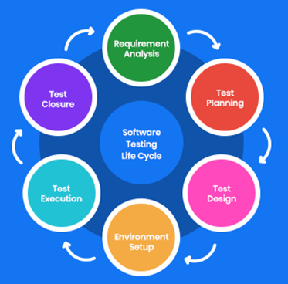
SOFTWARE TEST LIFE CYCLE
Testing
Types
STLC
Planning
Environment
Closure
Terminology
SDLC
Benefits
Levels
Requirement
Development
Execution
Bug-LC

Slide 12
SOFTWARE TEST LIFE CYCLE (STLC)
Requirement Analysis
Test Planning
Test case development
Test Environment setup
Test Execution
Test closure
Each of these stages has a definite Entry and Exit criteria, Activities & Deliverables associated with it.
Entry Criteria: Entry Criteria gives the prerequisite items that must be completed before testing can begin.
Exit Criteria: Exit Criteria defines the items that must be completed before testing can be concluded
Testing
Types
STLC
Planning
Environment
Closure
Terminology
SDLC
Benefits
Levels
Requirement
Development
Execution
Bug-LC

Slide 13
REQUIREMENT ANALYSIS
During this phase, test team studies the requirements from a testing point of view to identify the testable requirements.
The QA team may interact with various stakeholders (Client, Business Analyst, Technical Leads, System Architects etc) to understand the requirements in detail.
Requirements could be either Functional (defining what the software must do) or Non Functional (defining system performance /security availability ). Automation feasibility for the given testing project is also done in this stage.
Activities:
Identify types of tests to be performed.
Gather details about testing priorities and focus.
Prepare Requirement Traceability Matrix (RTM).
Identify test environment details where testing is supposed to be carried out.
Automation feasibility analysis (if required).
Deliverables
RTM
Automation feasibility report. (if applicable)
Testing
Types
STLC
Planning
Environment
Closure
Terminology
SDLC
Benefits
Levels
Requirement
Development
Execution
Bug-LC

Slide 14
TEST PLANNING
Typically, in this stage, a Senior QA manager will determine effort and cost estimates for the project and would prepare and finalize the Test Plan. In this phase, Test Strategy is also determined.
Activities
Preparation of test plan/strategy document for various types of testing
Test tool selection
Test effort estimation
Resource planning and determining roles and responsibilities.
Training requirement
Deliverables
Test plan /strategy document.
Effort estimation document.
Testing
Types
STLC
Planning
Environment
Closure
Terminology
SDLC
Benefits
Levels
Requirement
Development
Execution
Bug-LC

Slide 15
TEST CASE DEVELOPMENT
This phase involves the creation, verification and rework of test cases & test scripts. Test data, is identified/created and is reviewed and then reworked as well.
Activities
Create test cases, automation scripts (if applicable)
Review and baseline test cases and scripts
Create test data (If Test Environment is available)
Deliverables
Test cases/scripts
Test data
Testing
Types
STLC
Planning
Environment
Closure
Terminology
SDLC
Benefits
Levels
Requirement
Development
Execution
Bug-LC

Slide 16
TEST ENVIRONMENT SETUP
Test environment decides the software and hardware conditions under which a work product is tested. Test environment set-up is one of the critical aspects of testing process and can be done in parallel with Test Case Development Stage.
Activities
Understand the required architecture, environment set-up and prepare hardware and software requirement list for the Test Environment.
Setup test Environment and test data
Perform smoke test on the build
Deliverables
Environment ready with test data set up
Smoke Test Results.
Testing
Types
STLC
Planning
Environment
Closure
Terminology
SDLC
Benefits
Levels
Requirement
Development
Execution
Bug-LC

Slide 17
TEST EXECUTION
During this phase, the testers will carry out the testing based on the test plans and the test cases prepared. Bugs will be reported back to the development team for correction and retesting will be performed.
Activities
Execute tests as per plan
Document test results, and log defects for failed cases
Map defects to test cases in RTM
Retest the Defect fixes
Track the defects to closure
Deliverables
Completed RTM with the execution status
Test cases updated with results
Defect reports
Testing
Types
STLC
Planning
Environment
Closure
Terminology
SDLC
Benefits
Levels
Requirement
Development
Execution
Bug-LC

Slide 18
TEST CLOSURE
Testing team will meet, discuss and analyze testing artifacts to identify strategies that have to be implemented in the future, taking lessons from the current test cycle. The idea is to remove the process bottlenecks for future test cycles and share best practices for any similar projects in the future.
Activities
Evaluate cycle completion criteria based on Time, Test coverage, Cost,Software, Critical Business Objectives, Quality
Prepare test metrics based on the above parameters.
Document the learning out of the project
Prepare Test closure report
Qualitative and quantitative reporting of quality of the work product to the customer.
Test result analysis to find out the defect distribution by type and severity.
Deliverables
Test Closure report
Test metrics
Testing
Types
STLC
Planning
Environment
Closure
Terminology
SDLC
Benefits
Levels
Requirement
Development
Execution
Bug-LC

Slide 19
TYPES OF SOFTWARE TESTING
WHITE BOX TESTING
BLACK BOX TESTING
GREY BOX TESTING
White Box Testing: It is also called as Glass Box, Clear Box, Structural Testing. White Box Testing is based on application’s internal code structure. In white-box testing, an internal perspective of the system, as well as programming skills, are used to design test cases. This testing is usually done at the unit level.
Black Box Testing: It is also called as Behavioral/Specification-Based/Input-Output Testing. Black Box Testing is a software testing method in which testers evaluate the functionality of the software under test without looking at the internal code structure.
Grey Box Testing: Grey box is the combination of both White Box and Black Box Testing. The tester who works on this type of testing needs to have access to design documents. This helps to create better test cases in this process.
No matter whether you are a Black box, White box, or Grey box tester. The success of a project due to testing in Software Engineering has a huge role.
Testing
Types
STLC
Planning
Environment
Closure
Terminology
SDLC
Benefits
Levels
Requirement
Development
Execution
Bug-LC

Slide 20
LEVELS OF TESTING
Unit Testing
Integration Testing
System Testing
Acceptance Testing
Unit Testing: It is done to check whether the individual modules of the source code are working properly. i.e. testing each and every unit of the application separately by the developer in the developer’s environment. It is AKA Module Testing or Component Testing.
Integration Testing: Every software application contains multiple modules that converse with each other through an interface. Integrating these individual software modules and testing them together is known as Software Integration Testing.
System Testing (End to End Testing): It’s a black box testing. Testing the fully integrated application this is also called as an end to end scenario testing. To ensure that the software works in all intended target systems. Verify thorough testing of every input in the application to check for desired outputs. Testing of the user’s experiences with the application.
Acceptance Testing: To obtain customer sign-off so that software can be delivered and payments received. Types of Acceptance Testing are Alpha, Beta & Gamma Testing.
Testing
Types
STLC
Planning
Environment
Closure
Terminology
SDLC
Benefits
Levels
Requirement
Development
Execution
Bug-LC

Slide 21
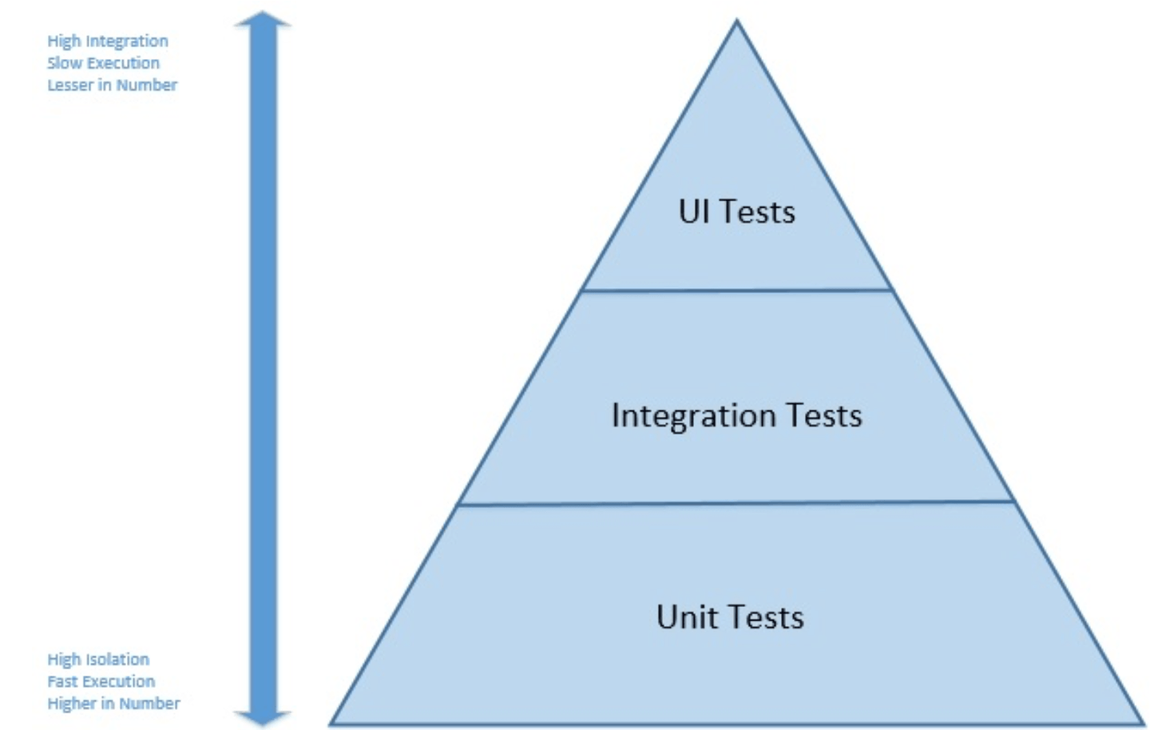
Testing Pyramid
Testing
Types
STLC
Planning
Environment
Closure
Terminology
SDLC
Benefits
Levels
Requirement
Development
Execution
Bug-LC

Slide 22
What Is A Defect?
A Defect, in simple terms, is a flaw or an error in an application that is restricting the normal flow of an application by mismatching the expected behavior of an application with the actual one.
The defect occurs when any mistake is made by a developer during the designing or building of an application and when this flaw is found by a tester, it is termed as a defect.
It is the responsibility of a tester to do thorough testing of an application to find as many defects as possible to ensure that a quality product will reach the customer. It is important to understand the defect life cycle before moving to the workflow and different states of the defect.

Slide 23
Defect Life Cycle In Detail
Defect Life Cycle or Bug Life Cycle in software testing is the specific set of states that defect or bug goes through in its entire life. The purpose of Defect life cycle is to easily coordinate and communicate current status of defect which changes to various assignees and make the defect fixing process systematic and efficient.

Slide 24
Defect Life Cycle In Detail
New: When a new defect is logged and posted for the first time. It is assigned a status as NEW.
Assigned: Once the bug is posted by the tester, the lead of the tester approves the bug and assigns the bug to the developer team
Fixed: When a developer makes a necessary code change and verifies the change, he or she can make bug status as “Fixed.”
Retest: Tester does the retesting of the code at this stage to check whether the defect is fixed by the developer or not and changes the status to “Re-test.”
Verified: The tester re-tests the bug after it got fixed by the developer. If there is no bug detected in the software, then the bug is fixed and the status assigned is “verified.”
Reopen: If the bug persists even after the developer has fixed the bug, the tester changes the status to “reopened”. Once again the bug goes through the life cycle.
Closed: If the bug is no longer exists then tester assigns the status “Closed.”
Duplicate: If the defect is repeated twice or the defect corresponds to the same concept of the bug, the status is changed to “duplicate.”
Rejected: If the developer feels the defect is not a genuine defect then it changes the defect to “rejected.”
Deferred: If the present bug is not of a prime priority and if it is expected to get fixed in the next release, then status “Deferred” is assigned to such bugs

Slide 25
DEFECT LIFE CYCLE
New
Assigned
Rejected
Deferred
Reopened
Fixed
FAIL
Duplicate
Retested
PASS
Verified
Closed
Testing
Types
STLC
Planning
Environment
Closure
Terminology
SDLC
Benefits
Levels
Requirement
Development
Execution
Bug-LC

Slide 26
KEY TERMINOLOGIES
AUT – Application Under Test
UAT – User Acceptance Testing
Dev – Development
QA – Quality Assurance / Testing
Prod/Live – Production
Smoke Test : Critical test cases to be executed in the QA environment. (Sort of a pre-condition for integration testing)
Regression Test: It’s a complete end to end testing of an application including the all possible scenarios (positive, negative, empty)
Sanity Test: Critical tests to be executed in the production environment (Generally includes only positive scenarios)
Testing
Types
STLC
Planning
Environment
Closure
Terminology
SDLC
Benefits
Levels
Requirement
Development
Execution
Bug-LC

Slide 28
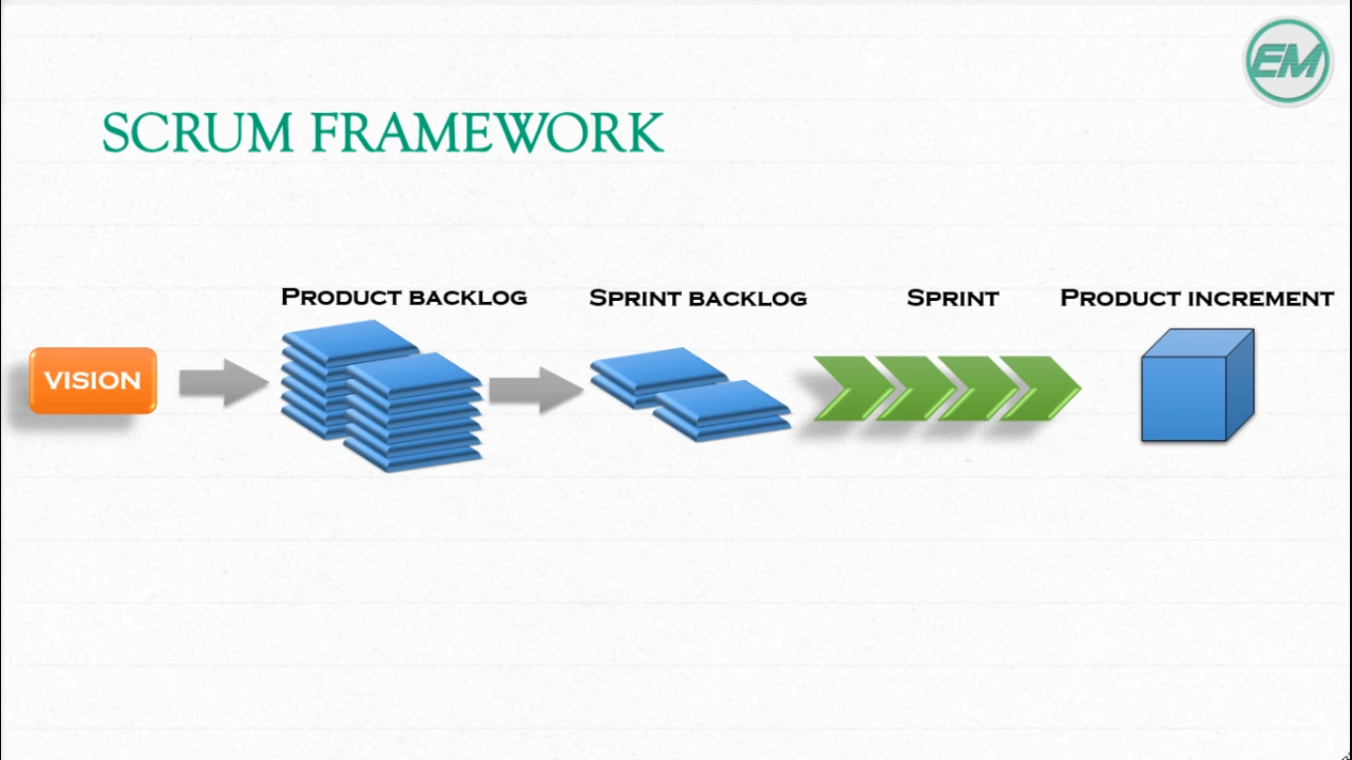
Agile Scum Model

